Slide 1
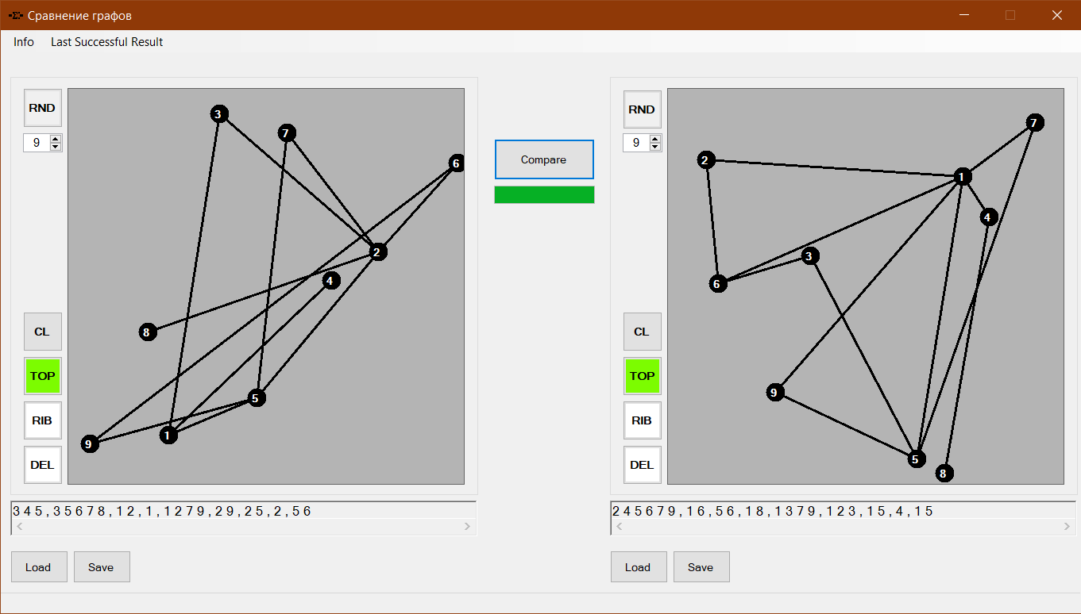
3
4
2
5
6
1
8
7

Slide 2
UI
Library
MainForm
Graph
Top
ResultForm
Rib
AboutProgram

